Slide 1

Objective for On-policy Prediction
Notes:
1

Slide 2
Objectives
Understand the mean-squared value error objective for policy evaluation
Understand the gradient descent and how gradient descent apply in Reinforcement Learning
Understand how state aggregation can be used to approximate the value function
Objective for On-policy Prediction
2
Notes:
2

Slide 3
The Value Error Objective
In reinforcement learning, the mean-squared value error objective is a common method used for policy evaluation, particularly when estimating value functions.
This objective is used to train models to predict the value function associated with a given policy.
Objective for On-policy Prediction
3
Notes:
3

Slide 4
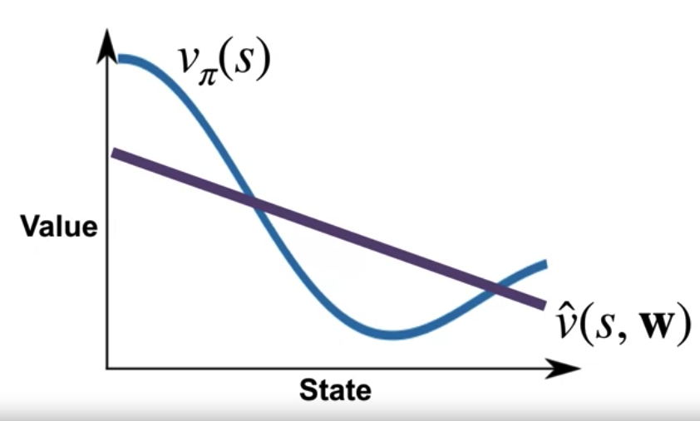
The Value Error Objective
V is true values, V hat is estimate values
our approximation of V Pi is not perfect, but how far off is it?
Objective for On-policy Prediction
4
Notes:
4

Slide 5
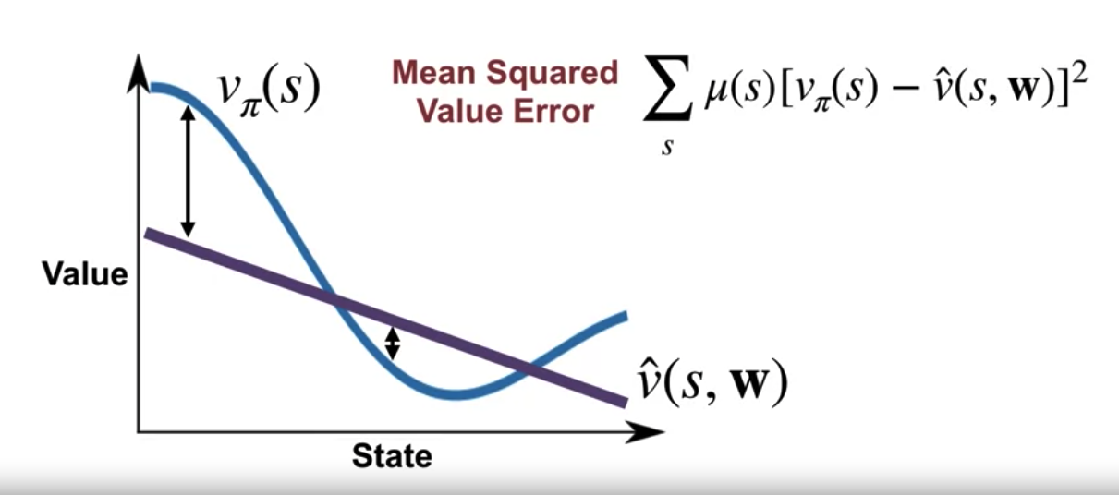
The Value Error Objective
Define a measure of the error between the value of a state and the approximate value.
Objective for On-policy Prediction
5
Notes:
5

Slide 6
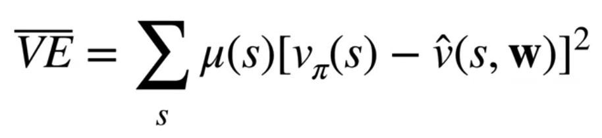
The Value Error Objective
Adapting the weights to minimize the mean squares value error objective
We want to adapt or weights to make the Mean Squared Value Error as low as possible.
We will call this objective VE bar.
Changing the weights in one way may increase the value error while changing them in a different way might decrease the value error.
Objective for On-policy Prediction
6
Notes:
6

Slide 7
Introducing Gradient Descent
Gradient descent is often used to optimize the policy or value function towards better performance in the environment.
Gradient descent is a powerful optimization algorithm used in reinforcement learning to update the parameters of the learning algorithm towards better performance in the environment.
It allows RL agents to learn from experience and adapt their behavior to achieve their goals more effectively
Objective for On-policy Prediction
7
Notes:
7

Slide 8
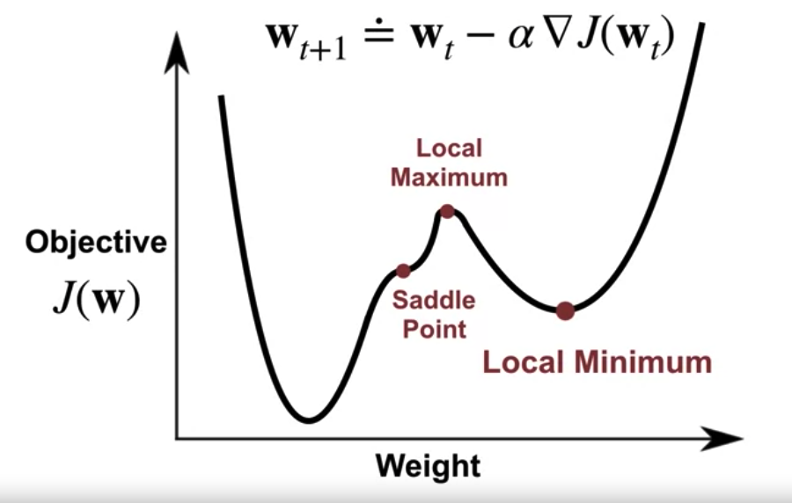
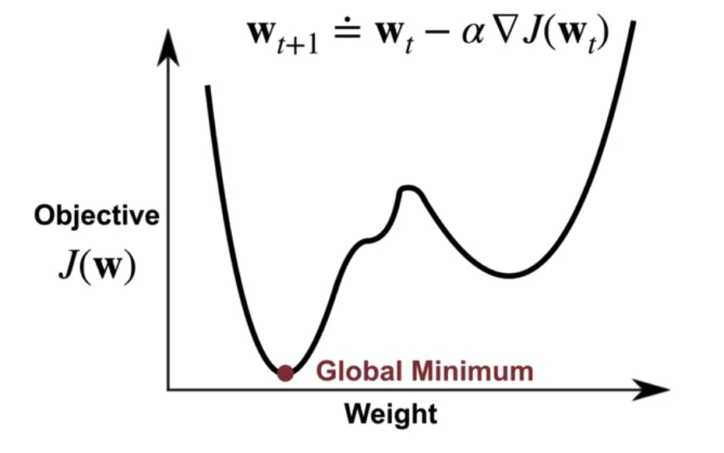
Introducing Gradient Descent
Local minimum
Local maximum
Global minimum
Objective for On-policy Prediction
8
Notes:
8

Slide 9
Gradient Descent in RL
Policy Gradient Methods:
In policy gradient methods, the agent directly learns a parameterized policy function πθ(a∣s), where θ represents the parameters of the policy.
The objective is to maximize the expected return by adjusting the policy parameters.
The gradient of the expected return with respect to the policy parameters is computed using techniques like the policy gradient theorem
Objective for On-policy Prediction
9
Notes:
9

Slide 10
Gradient Descent in RL
Policy Gradient Methods:
Gradient descent is then applied to update the policy parameters in the direction of the gradient, aiming to increase the likelihood of actions that lead to higher returns.
This process continues iteratively, with the agent exploring the environment, collecting experiences, computing gradients, and updating the policy parameters to improve its performance.
Objective for On-policy Prediction
10
Notes:
10

Slide 11
Introducing Gradient Descent
Value Function Approximation:
The agent learns to estimate value functions, such as the state-value function V(s) or the action-value function Q(s,a), using parameterized functions.
The objective is to minimize the mean-squared error or the temporal difference error between predicted and observed returns.
Objective for On-policy Prediction
11
Notes:
11

Slide 12
Introducing Gradient Descent
Value Function Approximation:
Gradient descent is used to update the parameters of the value function approximation towards minimizing the objective function.
Value function approximation can be used in combination with policy improvement techniques, such as Q-learning or SARSA, to derive optimal policies.
Objective for On-policy Prediction
12
Notes:
12

Slide 13
Introducing Gradient Descent
Off-Policy Methods:
Off-policy methods: learn from experiences generated by a different behavior policy than the one being improved.
Gradient descent is used to update the parameters of the value function approximation towards minimizing the temporal difference error, even if the experiences were collected using a different policy.
Objective for On-policy Prediction
13
Notes:
13

Slide 14
Introducing Gradient Descent
Actor-Critic Methods:
Actor-critic methods combine aspects of both policy gradient and value-based approaches.
The actor represents the policy function, while the critic evaluates the value function.
The actor's parameters are updated using policy gradients, while the critic's parameters are updated using value-based methods like temporal difference learning.
Gradient descent is used to update both the actor's and critic's parameters to improve the agent's policy and value estimates simultaneously.
Objective for On-policy Prediction
14
Notes:
14

Slide 15
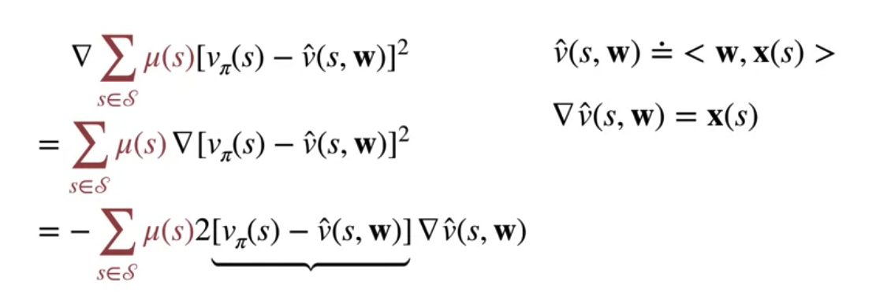
Gradient for Policy Evaluation
The gradient of the value function approximation indicates how to change the weights to increase the value for that state.
Objective for On-policy Prediction
15
Notes:
15

Slide 16
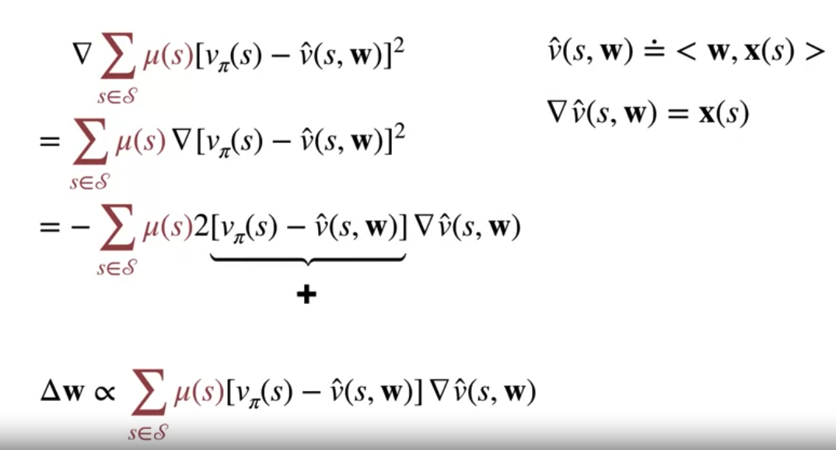
Gradient for Policy Evaluation
If the difference is positive (the true value is higher than our estimate)→ we should change the weights in the direction that increases our estimate.
Objective for On-policy Prediction
16
Notes:
16

Slide 17
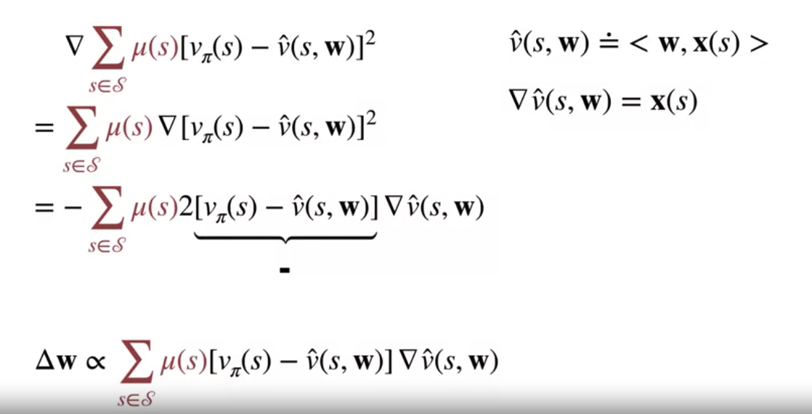
Gradient for Policy Evaluation
If the current error is negative, we should change the weights in the opposite direction.
Objective for On-policy Prediction
17
Notes:
17

Slide 18
State Aggregation
State aggregation is a useful technique in RL for approximating the value function in large state spaces, allowing agents to generalize their experience and learn more efficiently.
By grouping similar states together, state aggregation enables the agent to focus on important state features while reducing computational complexity.
Objective for On-policy Prediction
18
Notes:
18

Slide 19
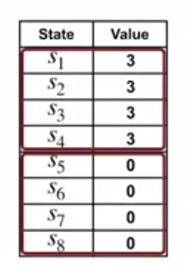
State Aggregation
In this table of eight states, we might choose to aggregate states together in groups of four.
So now instead of a table of eight entries for the value function, we just have two.
When we update the value of any state in the first group, the values of all the other states in that group is updated.
Objective for On-policy Prediction
19
Notes:
19

Slide 20
State Aggregation
State aggregation is another example of linear function approximation.
There is one feature for each group of states.
Each feature will be 1 if the current state belongs to the associated group, and 0 otherwise.
The approximate value of a state is the weight associated with the group that state belongs to.
Objective for On-policy Prediction
20
Notes:
20

Slide 21
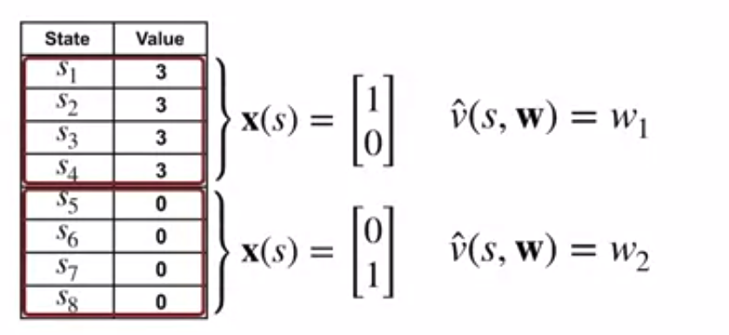
State Aggregation
Objective for On-policy Prediction
21
Notes:
21

Slide 22
Summary
Understand the mean-squared value error objective for policy evaluation
Understand the gradient descent and how gradient descent apply in Reinforcement Learning
Understand how state aggregation can be used to approximate the value function
Objective for On-policy Prediction
22

Slide 23
Q & A
Objective for On-policy Prediction
23

